Slide 1

Notes:
Introduction & Hook: Welcome everyone. Over the next 18 to 24 months, we are witnessing a fundamental shift in tech and growth. A new, highly lucrative role is emerging—what we call the Marketing Engineer, or the "Forward Deployed Marketer" / "AI Growth Operator".
The Core Value Proposition: Why is this a $250k–$1M+ role? Because every company wants faster experiments, sharper positioning, deeper customer understanding, and a marketing architecture that automatically gets smarter every single week with a smaller, hyper-efficient team.
The Paradigm Shift: Traditional marketing relied on adding more headcount or agencies to scale. A Marketing Engineer uses AI agents, data, code, and human taste to build automated, agentic growth systems that operate 24/7 with sub-millisecond latency and continuous feedback loops.
What We’ll Cover: Today, we’ll analyze how marketing value has shifted over the decades, look at the 6 core automated growth engines, break down the AI tool stack, and walk through a tactical 30-day playbook to deploy your first Growth OS.
https://www.youtube.com/watch?v=8ZC1G1ezN5o

Slide 2
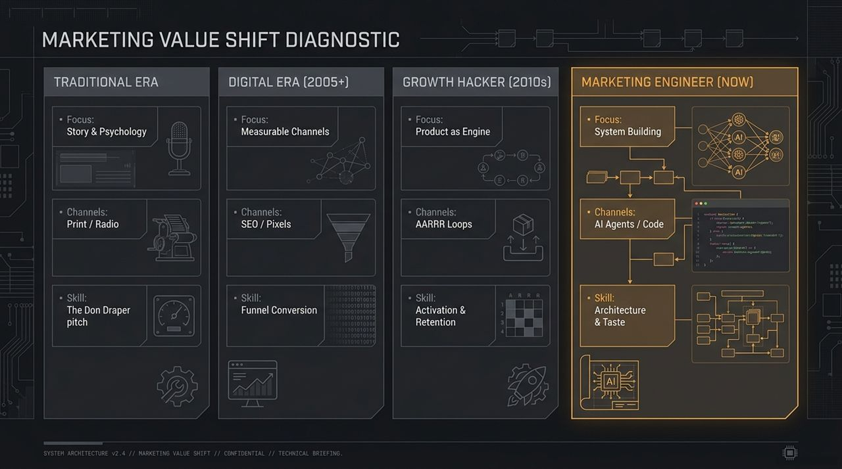
Notes:
Historical Context: To understand where we are going, we must look at how marketing has evolved through four major technology cycles:
Traditional Era (Don Draper Era): Focused on story, brand psychology, and traditional media like print and radio. The key skill was intuition and creative pitch.
Digital Era (2005+): Driven by search, pixels, SEO, and paid channels. Marketing became measurable, focusing heavily on funnel conversion metrics.
Growth Hacker Era (2010s): The product itself became the growth engine. Driven by pirate metrics (AARRR: Activation, Acquisition, Retention, Referral, Revenue) and software-driven virality.
Marketing Engineer Era (Now): Powered by AI Agents, code, and system architecture.
The Crucial Realization: Notice that each new era does not eliminate the previous skills. The Marketing Engineer still needs storytelling, channel understanding, and funnel analytics. However, because AI lowers the cost of average execution to near zero, human taste, judgment, and system architecture become the ultimate competitive moat.

Slide 3
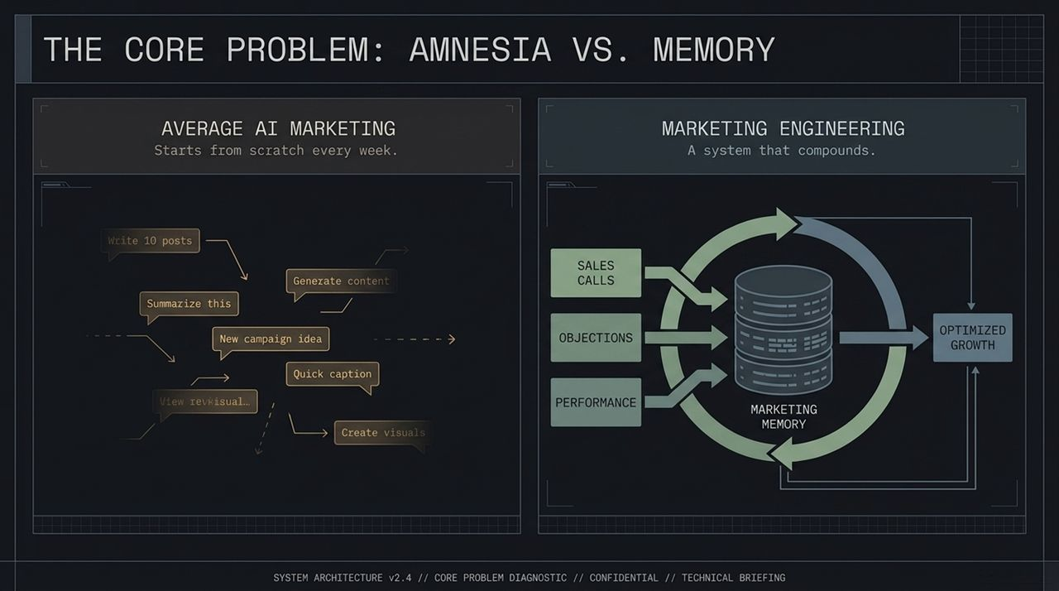
Notes:
Average AI Marketing (Amnesia): How do 95% of companies use AI today? They treat LLMs like a scratchpad. They open ChatGPT or Claude, type "Write 10 posts" or "Summarize this transcript," copy the output, and close the tab. Next week, they start entirely from scratch. The AI has zero memory of what worked, what failed, or what buyers actually care about.
Marketing Engineering (Compounding Memory): In contrast, a Marketing Engineering approach builds a centralized Marketing Memory.
The Closed Feedback Loop: We feed raw, real-world signals—such as sales call transcripts, customer objections, and ad performance data—into a centralized data engine. The system processes these signals, retains context, and continuously feeds updated prompts to AI workers to produce optimized, compounding growth.

Slide 4
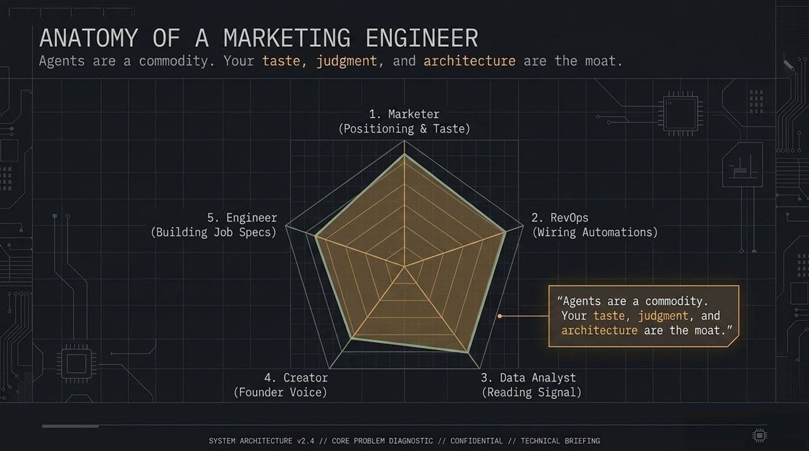
Notes:
Role Breakdown: What makes a Marketing Engineer unique is that they combine multiple cross-functional skill sets into a single operator:
Marketer: Deep positioning, messaging strategy, and human taste.
RevOps: Wiring automated workflows, triggers, and integrations.
Data Analyst: Reading market signals, conversion metrics, and isolating true quantitative performance.
Creator: Maintaining authentic founder voice and creative direction.
Engineer: Writing job specs for AI agents, managing repositories, and scripting systems.
The Key Takeaway: "Agents are a commodity. Your taste, judgment, and architecture are the moat." AI agents can execute tasks in seconds, but pointing them at the right problem and setting strict guardrails requires human expertise.

Slide 5
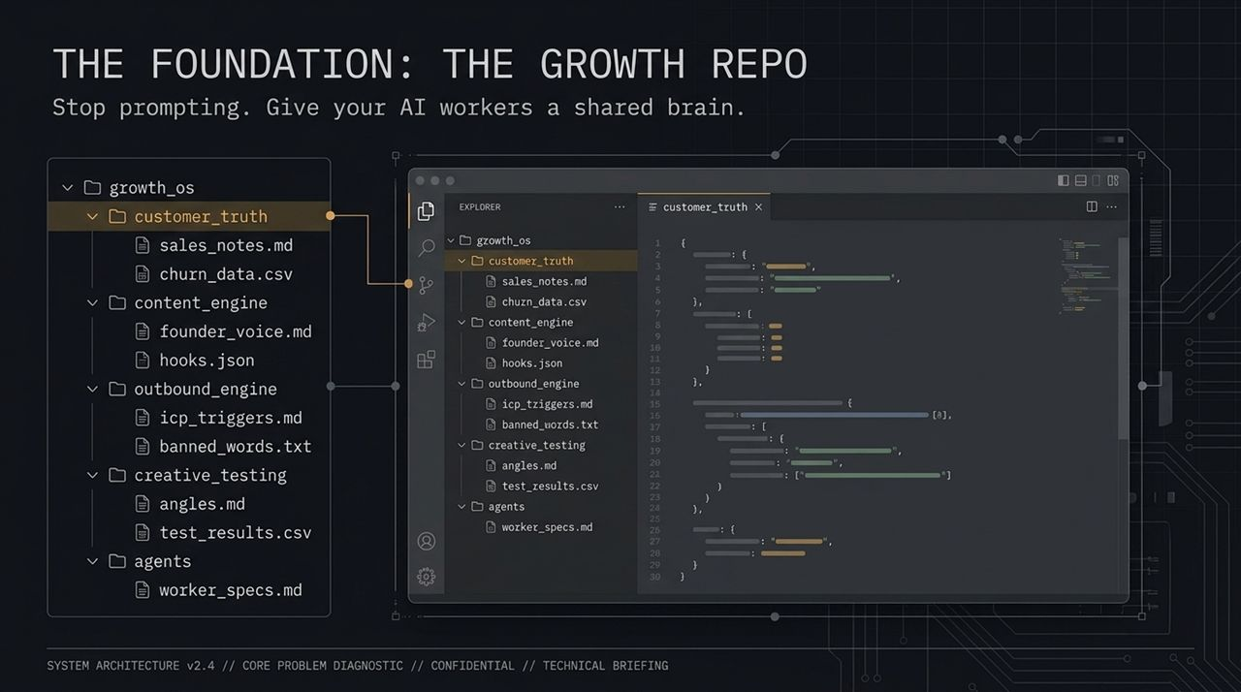
Notes:
Actionable First Step: Stop random chat prompting and give your AI workers a shared brain by building a Growth Repo (or a structured growth_os folder).
Folder Architecture Breakdown:
customer_truth/: Stores raw sales transcripts, churn logs, and support notes (e.g., sales_notes.md, churn_data.csv).
content_engine/: Holds tone guidelines, founder voice parameters, and high-performing copy hooks (founder_voice.md, hooks.json).
outbound_engine/: Keeps Ideal Customer Profile (ICP) triggers, account target criteria, and banned words/clichés (icp_triggers.md, banned_words.txt).
creative_testing/: Organizes visual angles and quantitative experiment records (angles.md, test_results.csv).
agents/: Contains explicit worker specifications and instructions (worker_specs.md).
Prompting Transformation: Instead of "Write a post about X," your prompt becomes: "Read sales_notes.md, filter by churn objections from this week, reference founder_voice.md, and generate 3 post angles."

Slide 6
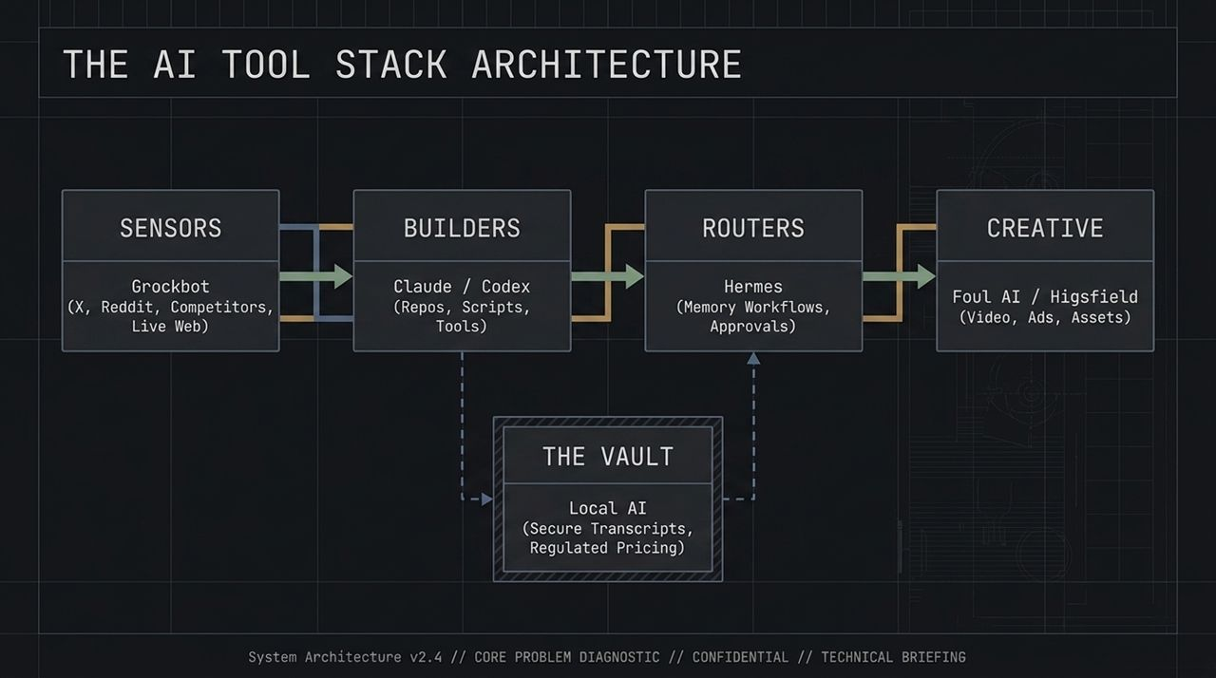
Notes:
System Layering: A mature Marketing Engineering stack divides AI agents by specialized functional layers:
Sensors (Grockbot): Connected directly to live internet feeds (X, Reddit, competitor sites) to detect shifts in audience conversation and market trends in real time.
Builders (Claude / Codex): Write code, update repository files, generate web pages/calculators, and run technical scripts.
Routers (Hermes): Manage scheduled operations, memory persistence, human-in-the-loop approval queues, and agent-to-agent workflows.
Creative (Foul AI / Higsfield): Rapidly generate programmatic video assets, ad variations, and design concepts.
The Vault (Local AI): Handles highly sensitive customer transcripts, private pricing structures, and regulatory compliance data securely without cloud exposure.

Slide 7
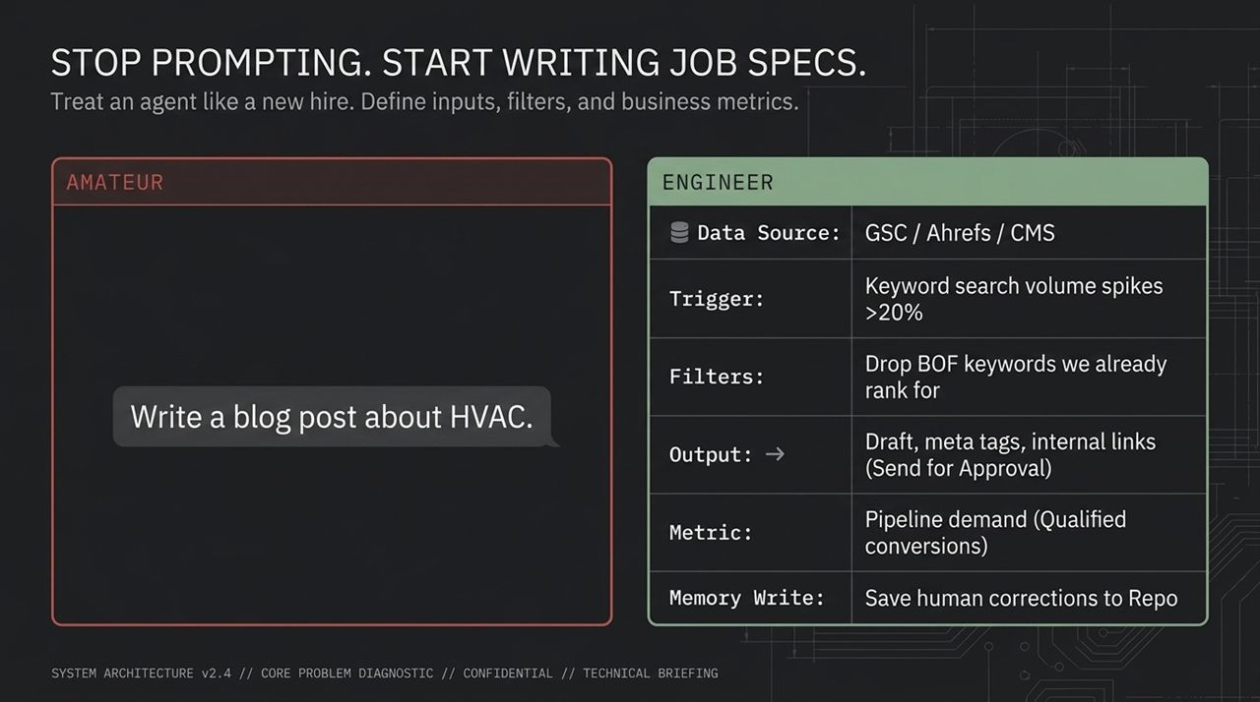
Notes:
Amateur vs. Engineer:
Amateur Approach: Gives vague, single-line prompts like "Write a blog post about HVAC." Output is generic, uninspired AI text.
Engineering Approach: Treats an AI agent like a new team hire by defining a complete, structured Job Spec.
The Job Spec Framework:
Data Source: Pull keyword spikes directly from GSC/Ahrefs.
Trigger: Initiate work when search volume increases by >20%.
Filters: Exclude existing bottom-of-funnel (BOF) keywords we already rank for.
Output: Generate draft post, meta tags, and internal link structure, then send to approval queue.
Metric: Track qualified conversion pipeline.
Memory Write: Save all human editor corrections back to the repository.

Slide 8
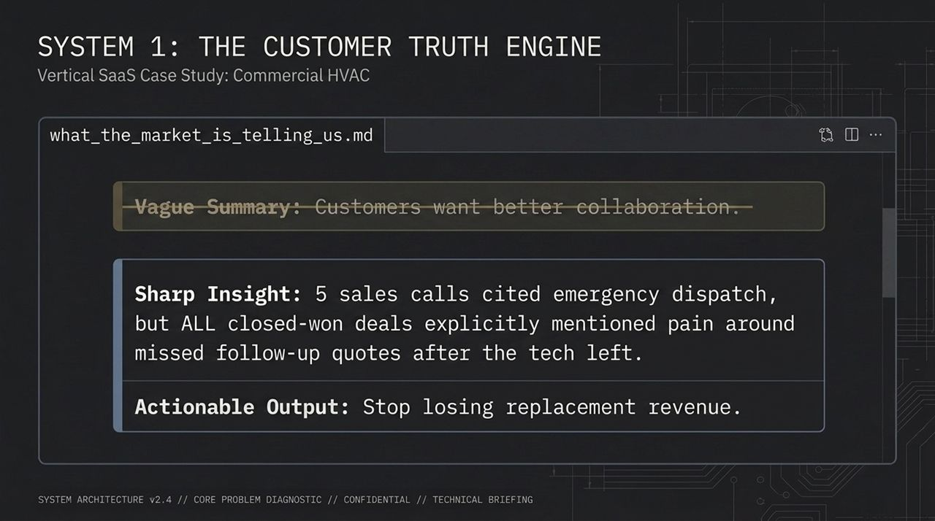
Notes:
Case Study Concept: Let's look at a concrete B2B example—a Vertical SaaS company selling software to Commercial HVAC contractors.
Synthesizing Real Signal: Most companies settle for vague feedback like "Customers want better collaboration."
The Markdown Output (what_the_market_is_telling_us.md): The Customer Truth Engine parses dozens of sales recordings to extract sharp, actionable insights:
Insight: 5 sales calls mentioned emergency dispatch, but 100% of closed-won deals specifically cited lost revenue from technicians failing to send follow-up quotes after leaving a job site.
Strategic Impact: Instead of positioning around generic "efficiency," the company pivots messaging to "Stop losing replacement revenue after service calls."

Slide 9
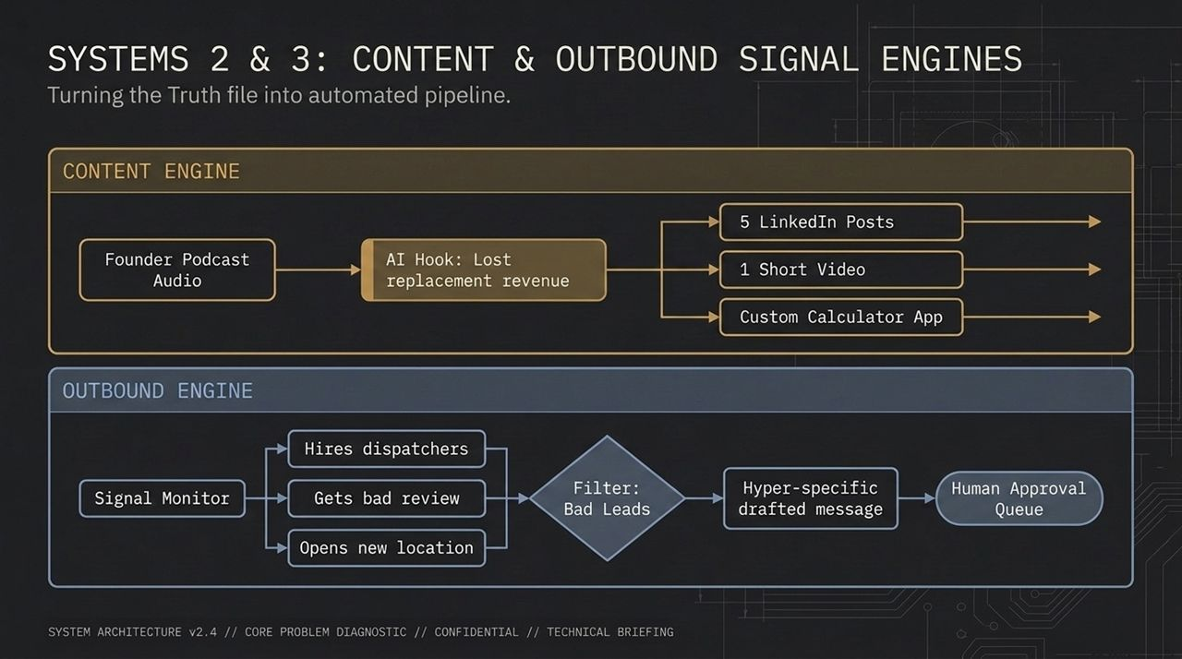
Notes:
System 2: Content Engine:
Ingest raw founder audio or podcast recordings.
Extract core hooks identified by the Customer Truth engine (e.g., "Lost Replacement Revenue").
Automatically generate derivative assets: 5 LinkedIn text posts, 1 short-form video script, and a micro-calculator app.
System 3: Outbound Signal Engine:
Move away from buying static email lists.
Monitor real-time intent triggers: contractors hiring dispatchers, receiving negative reviews regarding service delays, or opening new locations.
Pass filtered leads into an AI agent that drafts hyper-specific, personalized outreach messages and pushes them to a human approval queue.

Slide 10
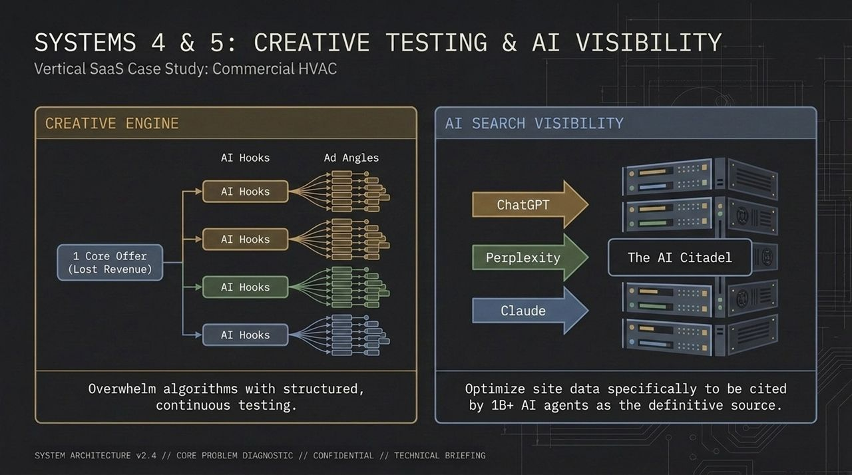
Notes:
System 4: Creative Engine (Algorithmic Volume):
Take 1 core offer ("Recover Lost HVAC Revenue") and generate dozens of distinct AI visual hooks and messaging angles.
Run continuous ad matrix tests to overwhelm ad platform algorithms with structured creative variety until winning variants emerge.
System 5: AI Search Visibility (GEO/AIO Optimization):
Over 1 billion users now query AI models directly (ChatGPT, Perplexity, Claude) for solutions.
System 5 structures your website, technical whitepapers, and documentation specifically so LLM web crawlers parse and cite your product as the definitive industry solution.

Slide 11
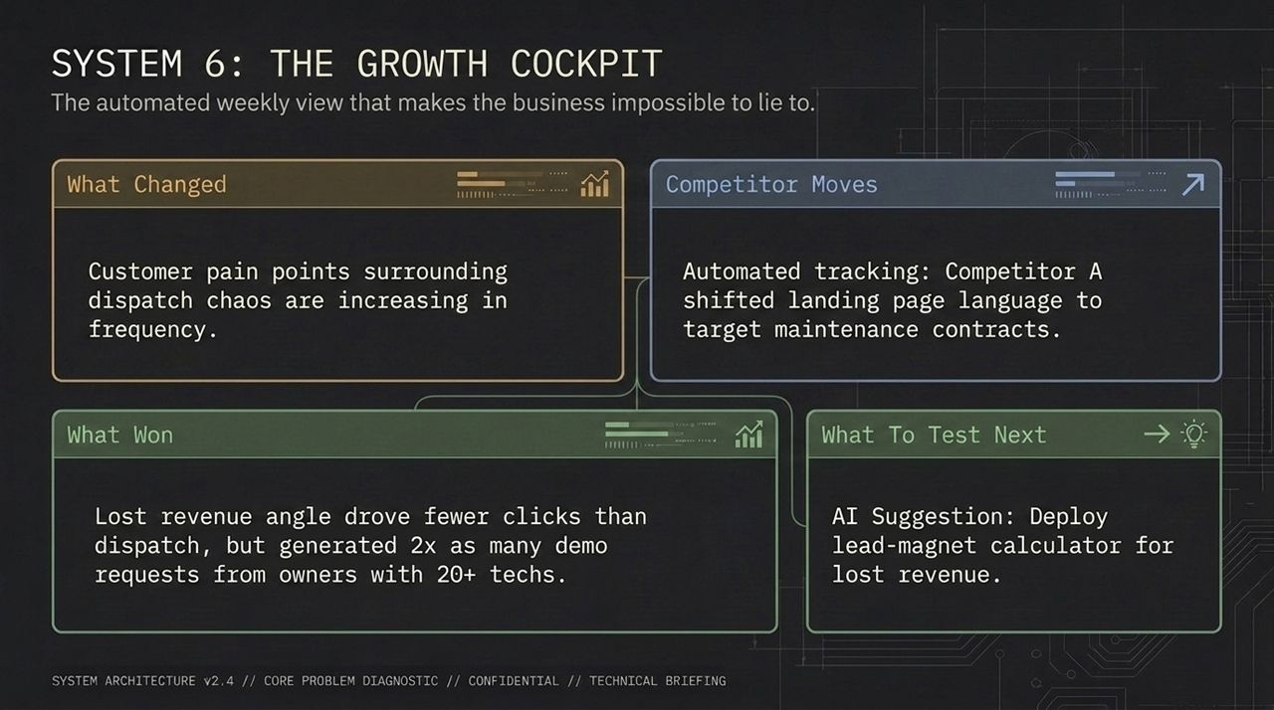
Notes:
Executive Overview: The Growth Cockpit is an automated weekly intelligence summary that keeps leadership grounded in objective market truth.
Four Core Dashboard Panels:
What Changed: Detects macro shifts in buyer pain points (e.g., rising complaints about dispatch bottlenecks).
Competitor Moves: Automatically tracks rival site updates, copy changes, and positioning shifts.
What Won: Isolates campaign deltas (e.g., "The lost revenue hook had fewer total clicks, but generated 2x as many high-value demo requests").
What To Test Next: Provides actionable, AI-suggested experiments for the upcoming sprint.

Slide 12
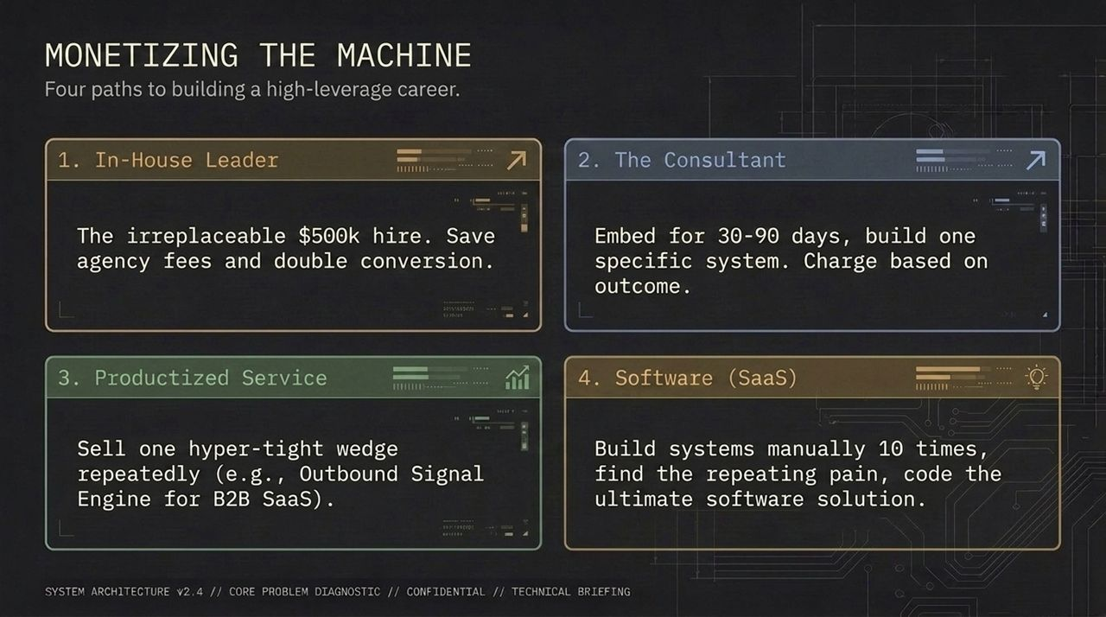
Notes:
Four Strategic Career Paths: How do you monetize this skill set to hit $250k–$1M+?
In-House Leader: Become an indispensable full-stack growth leader. Replace expensive agency retainer fees, scale pipeline internally, and command top-tier compensation.
The Consultant: Embed high-value 30-to-90-day sprints into companies. Build a custom Growth Repo or Outbound Engine, charging based on business outcome ($10k–$30k+/mo).
Productized Service: Focus on a single high-converting wedge (e.g., "Signal-driven outbound for Vertical SaaS") and repeat it at scale.
Software (SaaS): Manually deploy systems across multiple clients, identify repeating friction points, and code automated software solutions.

Slide 13
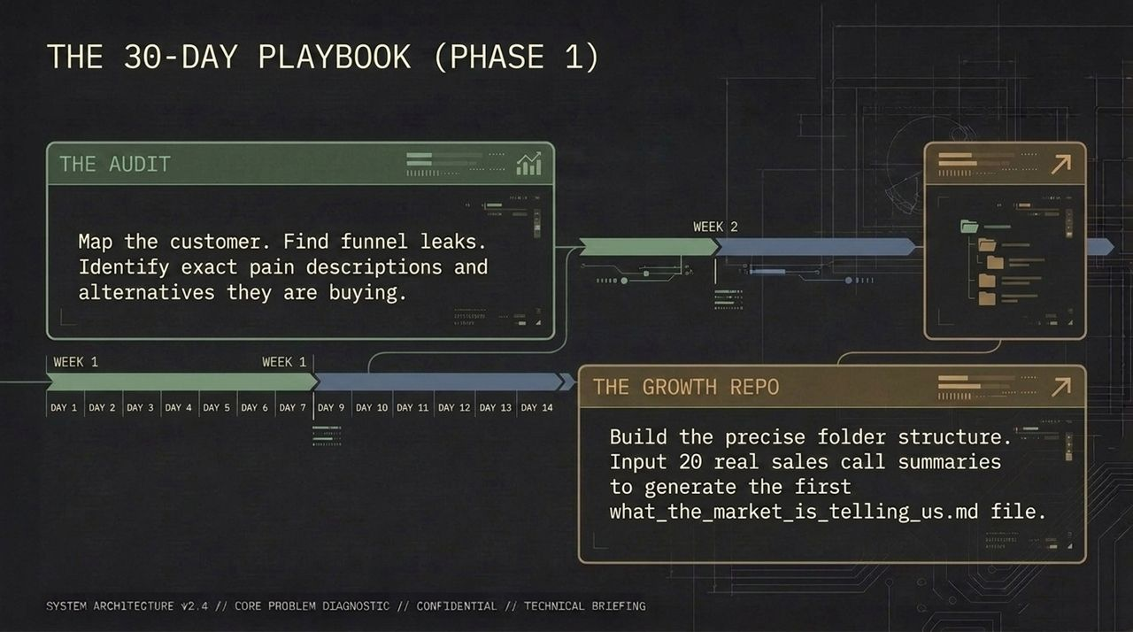
Notes:
Week 1: The Audit (Days 1–7):
Conduct deep customer discovery. Map exact buyer pain points, audit competitive alternatives, analyze existing sales call logs, and pinpoint precise conversion leaks.
Week 2: The Growth Repo (Days 8–14):
Set up the core directory structure (growth_os). Ingest 20+ real sales call transcripts into the customer_truth/ directory and generate your first automated what_the_market_is_telling_us.md intelligence brief.

Slide 14
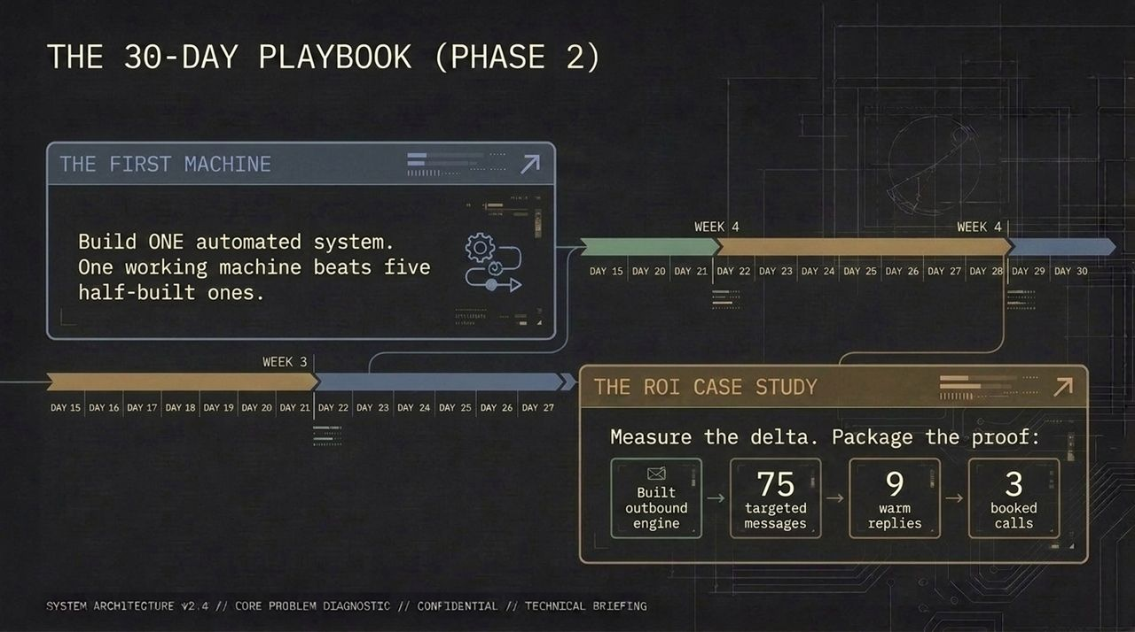
Notes:
Week 3: The First Machine (Days 15–21):
Focus entirely on shipping ONE working end-to-end automated system (e.g., Content Engine or Outbound Signal Engine). One functional machine provides far more value than five half-built concepts.
Week 4: The ROI Case Study (Days 22–30):
Measure performance deltas and package concrete proof of business impact.
Example Portfolio Result: "Built signal outbound engine ➔ Sent 75 targeted messages ➔ Generated 9 warm replies ➔ Booked 3 qualified demo calls."

Slide 15
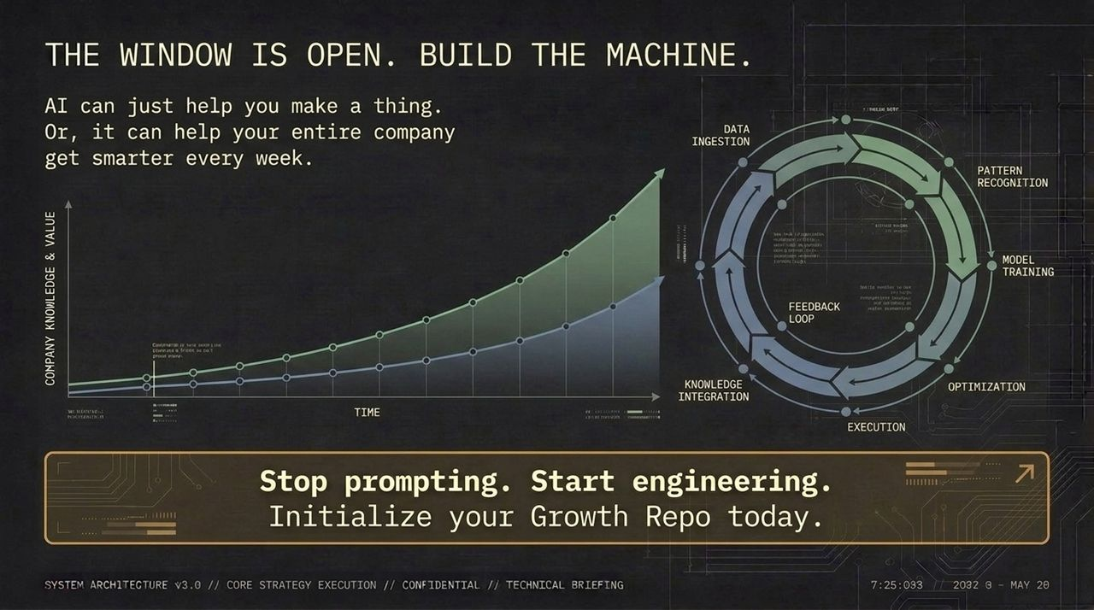
Notes:
The Strategic Choice: Organizations face a clear divide: use AI as a basic production tool to make assets faster, or build a systemic feedback engine that accelerates organizational intelligence week over week.
The Compounding Loop: Data Ingestion ➔ Pattern Recognition ➔ Model Training ➔ Optimization ➔ Execution ➔ Knowledge Integration.
Call to Action: The window of opportunity to build these agentic growth systems ahead of the market is open right now. Initialize your Growth Repo and start engineering.

Slide 16
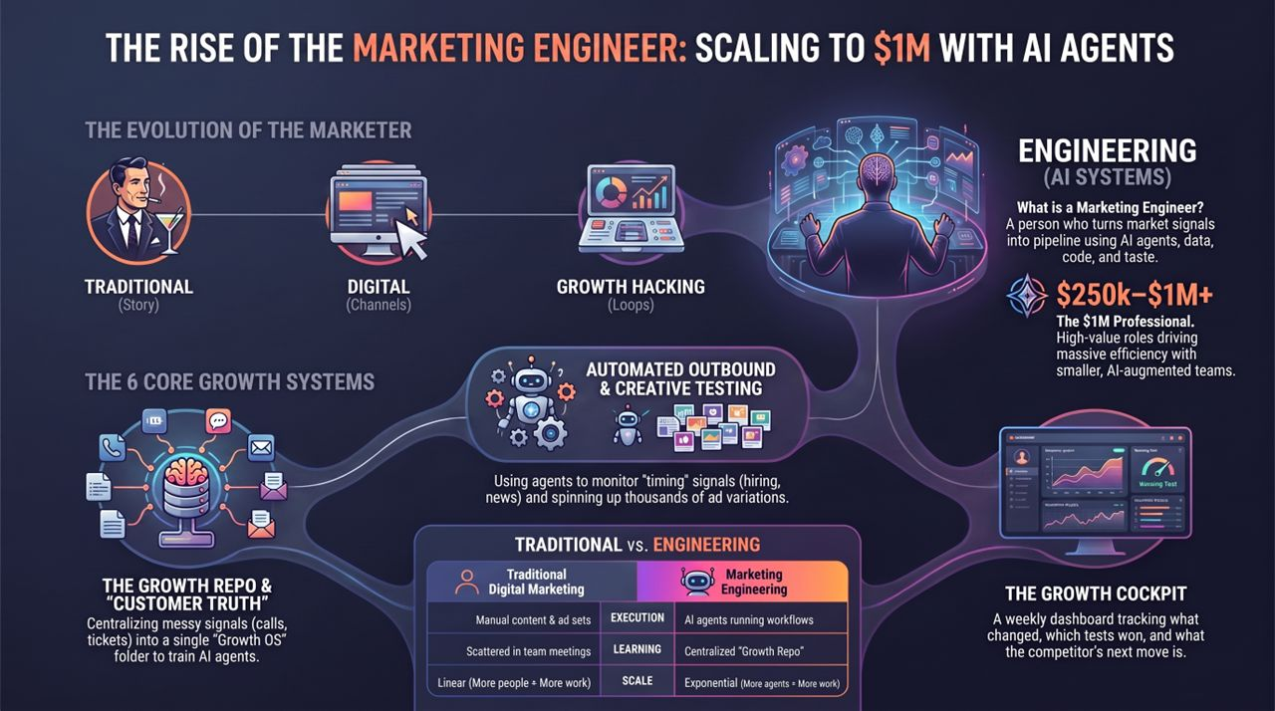
Notes:
Side-by-Side Comparison:
Execution: Traditional marketing relies on manual content creation and ad set management. Marketing Engineering uses autonomous AI agents executing structured workflows.
Learning: Traditional growth relies on scattered meeting notes. Marketing Engineering centralizes market signal inside a dynamic, persistent Growth Repo.
Scale: Traditional scaling is linear (more headcount = more output). Marketing Engineering scaling is exponential (more agentic systems = exponentially higher output).
Closing Perspective: This transition transforms growth teams into high-value revenue drivers. Master these systems to lead the next era of marketing engineering.

